Slide 1

Ecom-STORE
Submitted By :
Lovkush (2008085)
Mohd. Shariq (2008087)
Vinod Kumar (2008092)
Under the guidance of Excellence Technology

Slide 2
INTRODUCTION
E-comm, EC for short (E-commerce) is a concept referring to transactions, purchase and sale of goods and services by the internet.
Frontend✅ = React-JS & Redux
Backend✅ = Node & Express
Database✅ = MongoDB
Features ✅ = Fully Responsive, Login Auth, Data Fetching from The DB, Products Page, Single Product Page, All URL’s setup-ed using Router, Total Price, Add to cart , Increase The Item & Delete using Redux.

Slide 3

MERN
MERN stands for MongoDB, Express, React, Node
MERN Stack is a Javascript Stack that is used for easier and faster deployment of full-stack web applications.

Slide 4
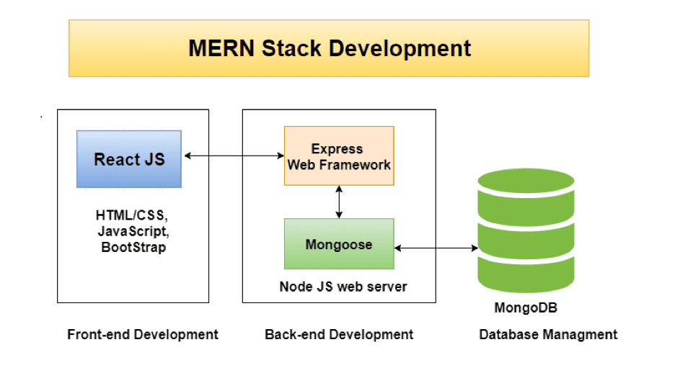
PROJECT : DESIGN

Slide 5
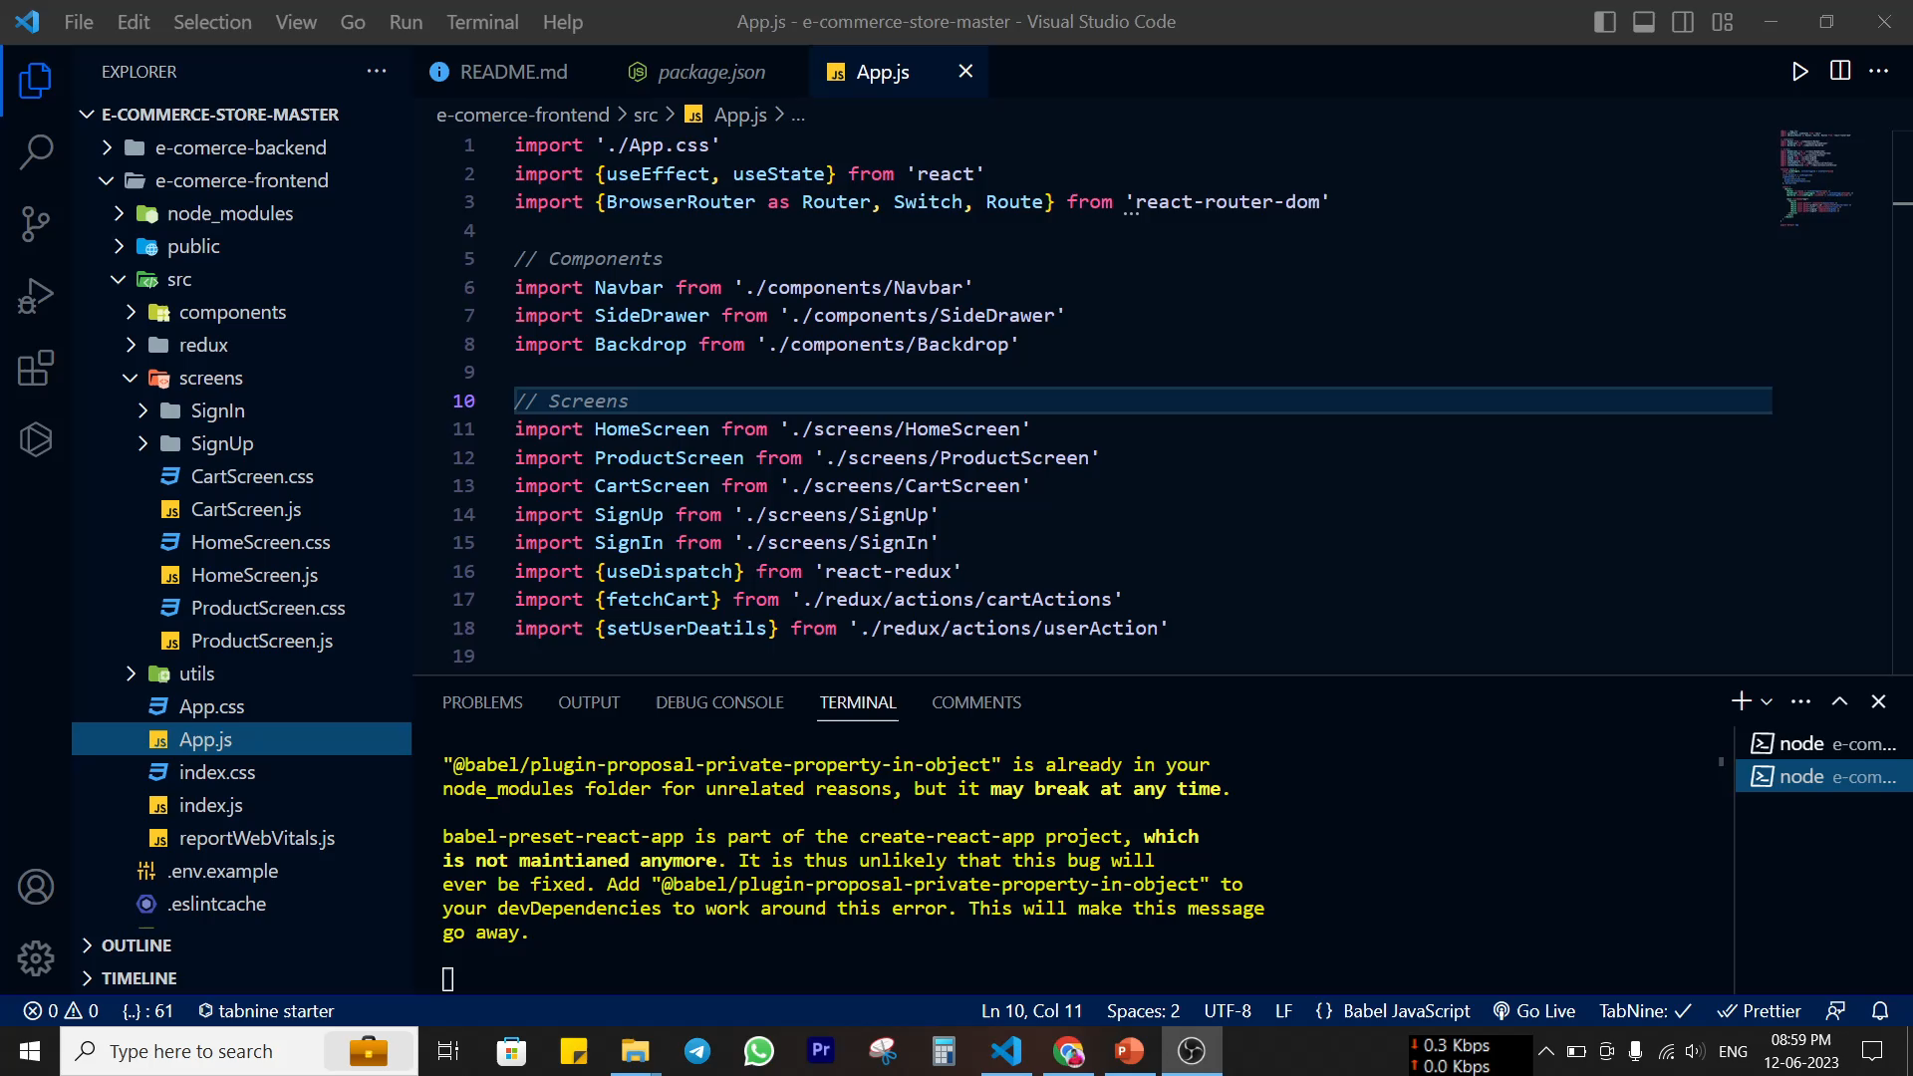
WORKING

Slide 6
THANKS
Any questions?
You can find me at:
Github : @LOVKUSH9888
lKY9888@gmail.com

